Slide 1
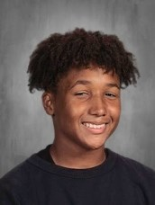
You Make AP a GREAT Place to BE!
Xander Agar—Grade 9
Xander is someone who has stepped up his game. He is willing to work hard, and share ideas with the class.
He participates and he steps in to read to the class as well as help peers if they need it.
Xander makes AP a better place!
Mrs. Gaboury

Slide 2
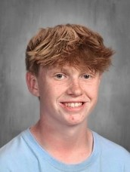
You Make AP a GREAT Place to BE!
Eli Amadon—Grade 9
Eli is an extremely hard worker.
He cares about his classes and his academic progress. He is able to focus and get his work done even with distractions from other students.
Eli is a rockstar student and sets a positive academic tone for the class. Mrs. Engels

Slide 3
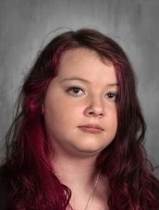
You Make AP a GREAT Place to BE!
Emily Bauer—Grade 9
Emily is someone who works really hard and is very resilient.
She steps up to participate and shares her deep thinking with the class, and is also willing to help anyone who needs it.
Emily makes AP a better place. Mrs. Gaboury

Slide 4
You Make AP a GREAT Place to BE!
Robert Bliss—Grade 9
Robert is curious and hard working!
He digs into his work and is excited to share with me what he has learned.
He volunteers in class and is willing to help peers.
He makes AP a better place!
Mrs. Gaboury

Slide 5
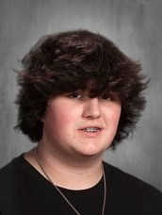
You Make AP a GREAT Place to BE!
Jeremy Bornt—Grade 9
Jeremy is always on time, always engaged and he asks great questions.
He helps others on assignments and has a great work ethic! Mr. Smith

Slide 6
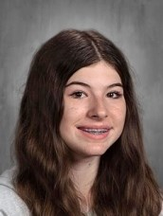
You Make AP a GREAT Place to BE!
Teagan Carrig—Grade 9
Teagan is a sweet, quiet, hard-working young lady.
She is always pleasant in class, helps others with work, and is always respectful.
She sets a wonderful tone for class even when others can be disruptive. Mrs. Engels

Slide 7
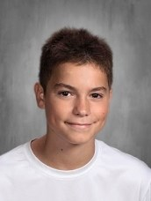
You Make AP a GREAT Place to BE!
Maxwell Clarkson—Grade 9
Max is hardworking and resilient.
Max is someone who steps in and up when he sees he can help (read in class, answer and participate in class, help peers catch up).
Max makes AP a better place!
Mrs. Gaboury

Slide 8
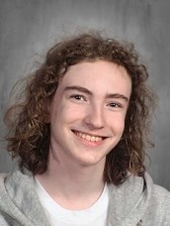
You Make AP a GREAT Place to BE!
Matthew Fizzuoglio—Grade 9
Matthew makes thoughtful contributions to science class and does great work.
He also takes the time to help his peers during lab and Advisory so they better understand the science concepts. Ms. Kehn

Slide 9
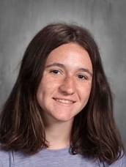
You Make AP a GREAT Place to BE!
Marley Hanlon—Grade 9
Marley is a committed and dedicated student.
She stays out of the drama and is always supportive and willing to help her fellow classmates.
She advocates for herself appropriately, is trustworthy, and responsible.
She's truly just one of the best students! . Mrs. Desiderio

Slide 10
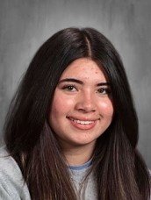
You Make AP a GREAT Place to BE!
Norah Hayes—Grade 9
Norah is always very respectful and diligent about her work in class.
Most importantly, Norah is a great friend and classmate to her peers.
Mr. Keegan

Slide 11
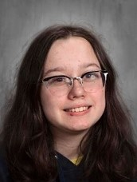
You Make AP a GREAT Place to BE!
Zoe McKinney—Grade 9
Zoe makes my B days awesome!
She is always happy to be in class, has a great sense of humor and works hard.
She is always kind and thoughtful, and generally sets a great example for her peers!
Mr. Smith

Slide 12
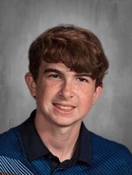
You Make AP a GREAT Place to BE!
Tyler Mercado—Grade 9
Tyler is someone who is always willing help a peer catchup or understand what is going on.
He works hard and stays focus even when others may be distracting. He is curious and considerate.
Tyler makes AP great!
Mrs. Gaboury

Slide 13
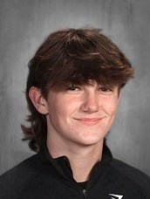
You Make AP a GREAT Place to BE!
Nathan Middleton—Grade 9
Nathan is someone who pays attention, focuses in, and does the best he can no matter who is around.
Nathan is willing to do the hard thinking work and he is also willing to help peers.
Nathan makes AP a better place! Mrs. Gaboury

Slide 14
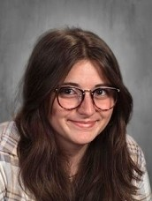
You Make AP a GREAT Place to BE!
Annabelle Passineau—Grade 9
Annabelle works real hard at being the strongest student and class member she can be.
Annabelle will participate in class, help peers catch up, and help me with regular things when I need it.
Annabelle makes AP a better place!
Mrs. Gaboury

Slide 15
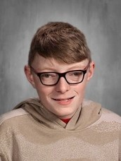
You Make AP a GREAT Place to BE!
Cole Schiller—Grade 9
Cole works with Kade to distribute the paper throughout the building.
He also helps to restock the facial tissue, His help is greatly appreciated.
Cole makes AP a Great Place to be.!
Mrs. Otty

Slide 16
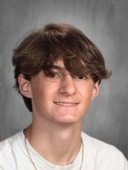
You Make AP a GREAT Place to BE!
Valentino Strano—Grade 9
Val is always focused in class and completes all assignments on time and done well!
He is respectful and attentive. He seeks for things he does not understand.
He knows the importance of education. Great kid! Mr. Minkler

Slide 17
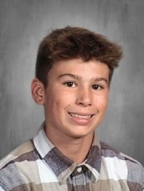
You Make AP a GREAT Place to BE!
Laden Welcome—Grade 9
Landen is such a hard-worker.
He is focused and determined to succeed and to learn as much as he can.
Landen is also very helpful and supportive to his peers.
Landen makes AP a better place. Mrs. Gaboury

