Slide 1
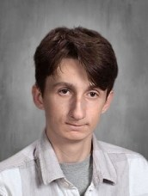
You Make AP a GREAT Place to BE!
Kade Baker—Grade 11
Kade makes my life easier.
He is in charge of restocking the copy paper throughout the building. He also restocks the facial tissue.
He does a great job and make AP a Great Place to be.
Mrs. Otty

Slide 2
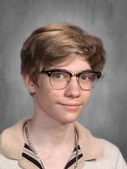
You Make AP a GREAT Place to BE!
Avery Blasier—Grade 11
Working hard, great kid
Mr. Duff

Slide 3
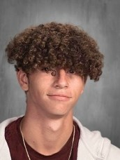
You Make AP a GREAT Place to BE!
Liam Fitch—Grade 11
In College Readiness & Research, Liam exemplifies extraordinary commitment and enthusiasm. As a proactive participant, he consistently leads discussions, readily volunteers answers, and demonstrates a remarkable ability to think innovatively.
He turns in all of his work on time and goes above and beyond in his academic writing.
Liam's unwavering determination to excel reflects his admirable dedication to personal growth and academic excellence. Mrs. Park

Slide 4
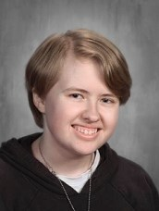
You Make AP a GREAT Place to BE!
Madison Grusczak—Grade 11
Madison makes great contributions to class and reliably improves our conversations.
She is thoughtful and hardworking and is nice to work with! Mrs. Garrison

Slide 5
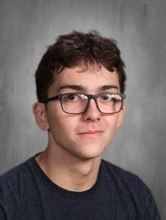
You Make AP a GREAT Place to BE!
Matthew Hoff—Grade 11
Great kid!
Mr. Duff

Slide 6
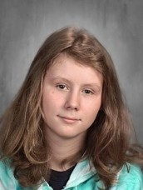
You Make AP a GREAT Place to BE!
Emma Hotaling—Grade 11
Emma has consistently been a hard worker and very helpful to her peers.
She spends as much time as she needs with me, outside of the class time, so that she feels confident in her learning.
Since she does know her “stuff” she is quick to explain ideas to others.
Emma is also super sweet and kind. She spreads joy through crafting items and sharing them. I love my two new bracelets!
Mrs. Quesnel

Slide 7
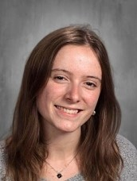
You Make AP a GREAT Place to BE!
Anastazia Marcy—Grade 11
Anastasia always has a positive attitude and she has a strong work ethic.
She is a pleasure to have in class and works well with other students.
It has been my privilege to have her in my class two years in a row. Mr. Goodnow

Slide 8
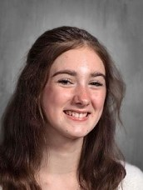
You Make AP a GREAT Place to BE!
Julia Neet—Grade 11
Julia truly is an exemplary student. She has shown a great deal of dedication, both in her work in the classroom, and in her extracurricular passions such as singing and theater.
Julia's presence in the classroom in a bright one. She frequently participates in class discussion (always with insightful thinking), she is willing to help her fellow students, and she is respectful to all those around her.
Julia's constant displaying of kindness and consideration makes her a student that many could learn from. Mr. Porter

Slide 9
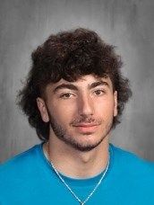
You Make AP a GREAT Place to BE!
Anthony Polaro—Grade 11
Anthony is a fun, personable student who makes class enjoyable.
His participation and his efforts in class contribute to our class culture in a positive way! Mrs. Garrison

Slide 10
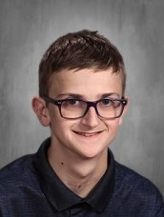
You Make AP a GREAT Place to BE!
Nathan Webster—Grade 11
Nathan is not only a good student, but also a wonderful person.
He is kind to each and every person he interacts with, whether that be staff or his fellow students.
Always engaging in academics or otherwise. Nathan is a great presence to have in class.
Many would do well to follow his examples of kindness, care, and enthusiasm!
Mr. Porter

Slide 11
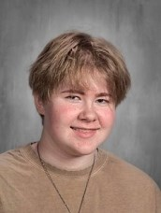
You Make AP a GREAT Place to BE!
Ash Zimmerman—Grade 11
Ash tirelessly worked on the musical taking the job of Promotions to the next level.
They had great ideas and executed them extremely well and also managed to help in other capacities whenever needed.
I am unendingly impressed with their accomplishments. Ms. Monroe

