Slide 1
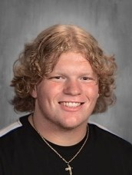
You Make AP a GREAT Place to BE!
Jack Behan—Grade 12
In early January of this school year I went to my vehicle to retrieve something during my lunch. That is when I learned I had a flat tire. This created a highly stressful scenario as I had to get my daughter to an important event immediately after varsity girls basketball practice ended at 4:30 later that afternoon. This is where three of Mr. Dutcher's auto tech students came to my aid. Amidst the subfreeing temperatures and driving winds...these three students worked together to quickly remove my tire from my vehicle, identify and remove the large nail that was responsible for the flat - and successfully patch the tire. He saved me a lot of stress, trouble, and the cost of a new tire. Their actions allowed me to get my daughter to her event later than afternoon.
While they were very happy to help their actions should be recognized and applauded for making AP a great place to be.
Mr. Organ

Slide 2
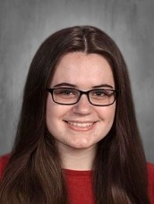
You Make AP a GREAT Place to BE!
Cecelia Colton —Grade 12
Cece is the student who is attentive to the teacher, supportive of peers, and hard working.
She gives everything full attention and is also not afraid to share her ideas with the class.
She is a contributor to the classroom and to the discussions.
Cece makes AP a better place! Mrs. Gaboury

Slide 3
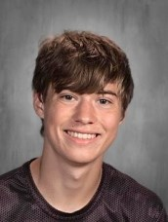
You Make AP a GREAT Place to BE!
Kevin Cooper—Grade 12
Kevin Cooper is an awesome kid to have in my Rock and Roll class.
He participates, has great ideas and is generally positive and thoughtful.
I really enjoy having him in my class! Ms. Monroe

Slide 4
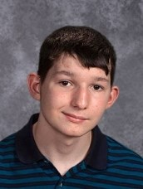
You Make AP a GREAT Place to BE!
John Grimmick—Grade 12
John is a conscientious, hard working student who is always willing to help and encourage others.
John makes AP a Great Place to Be!
Mrs. Daviero

Slide 5
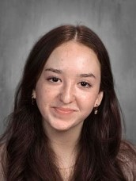
You Make AP a GREAT Place to BE!
Olivia Maddalone—Grade 12
Olivia is an all around great individual!
She is always willing to lend a hand and volunteer. As a class officer she has assisted in the planning of class events, and was integral to the Mr. AP performance in April.
Friendly, kind and helpful, Olivia has most certainly made AP a GREAT PLace to BE, and I will miss her!
Mrs. Leach

Slide 6
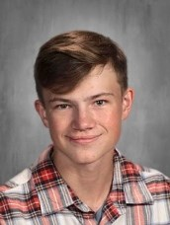
You Make AP a GREAT Place to BE!
Peter Nizinkirck—Grade 12
In early January of this school year I went to my vehicle to retrieve something during my lunch. That is when I learned I had a flat tire. This created a highly stressful scenario as I had to get my daughter to an important event immediately after varsity girls basketball practice ended at 4:30 later that afternoon. This is where three of Mr. Dutcher's auto tech students came to my aid. Amidst the subfreeing temperatures and driving winds...these three students worked together to quickly remove my tire from my vehicle, identify and remove the large nail that was responsible for the flat - and successfully patch the tire. He saved me a lot of stress, trouble, and the cost of a new tire. Their actions allowed me to get my daughter to her event later than afternoon.
While they were very happy to help their actions should be recognized and applauded for making AP a great place to be.
Mr. Organ

Slide 7
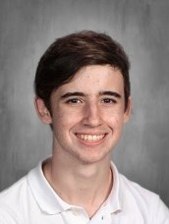
You Make AP a GREAT Place to BE!
James Pascarell—Grade 12
In early January of this school year I went to my vehicle to retrieve something during my lunch. That is when I learned I had a flat tire. This created a highly stressful scenario as I had to get my daughter to an important event immediately after varsity girls basketball practice ended at 4:30 later that afternoon. This is where three of Mr. Dutcher's auto tech students came to my aid. Amidst the subfreeing temperatures and driving winds...these three students worked together to quickly remove my tire from my vehicle, identify and remove the large nail that was responsible for the flat - and successfully patch the tire. He saved me a lot of stress, trouble, and the cost of a new tire. Their actions allowed me to get my daughter to her event later than afternoon.
While they were very happy to help their actions should be recognized and applauded for making AP a great place to be.
Mr. Organ

Slide 8
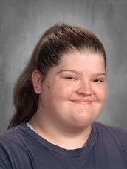
You Make AP a GREAT Place to BE!
Kayde Quinn—Grade 12
Kayde works hard and participates in school activities and in the community with orchestra Mrs. Ford

Slide 9
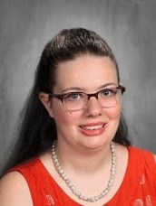
You Make AP a GREAT Place to BE!
Katherine Story—Grade 12
Katy is a very cheerful person that is always thinking about others. Mrs. Rohl
Katherine is always pleasant when collecting recycling in the Main Office.
She is inquisitive and always smiling. Mrs. Otty

Slide 10
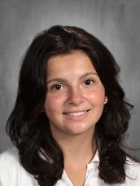
You Make AP a GREAT Place to BE!
Kay Tichy—Grade 12
Kay is hard working and loves to challenge herself.
She is someone who digs deep into understanding the material and is not afraid to share out to the class. She raises the discussion level.
Kay makes AP a better place! Mrs. Gaboury

